Slide 1
Canada and USA Energy Production vs. $$$ Strength
Project 1
Team: Kelvin Deng, Thao Hoang, May Ang, Yijing Su
Date: Nov 12, 2020

Slide 2
Agenda
Topic motivation
Work process (data exploration, transformation, and analysis)
Findings and implications
Next steps
Notes:
Su

Slide 3

Motivation
Energy and the Economics
Oil Exports and Dollar Strengths
Future of Renewable Energy and Dollar Strengths
Notes:
Su
In this project, we want to explore the correlation between Energy Production and the Economics of US and CA, in term of Oil Export, GDP, and dollars index or exchange rate
We will also look at renewable energy production trend, and find out if this will also impact the Economics in the near future

Slide 4

Motivation Background
Crude oil is the largest single contributor of Canada’s revenue from foreign exchanges.
The contribution of oil production and exports to the Canadian economy (GDP, dollars strength).
Similarly, for US.
CA production exported to US 2018:
Crude oil: 84% (48% of total US imports)
Notes:
Su
The reason we are interested in this topic is because we know that crude oil is the largest single contributor of Canada’s revenue. So it’s interested to see how increase or decrease in oil production and export affect the economy in term of GDP and dollar strength.
Since US is our neighbor, we will also look at the same trend for US
https://www.investopedia.com/articles/investing/021315/how-why-oil-impacts-canadian-dollar-cad.asp
Source; Energy Fact Book 2019-2020

Slide 5
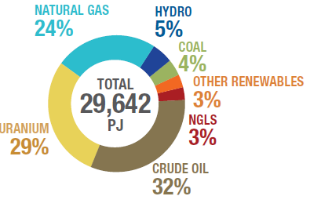
Motivation Background
Canada’s primary energy production 2017:
Crude oil 32%
Hydro and Other renewable: 8%
Notes:
Su
Renewable Energy sources currently provide about 16% of Canada's total primary energy supply
Despite the large oil reserve in Canada, the world is shifting towards using clean and renewable energy in the near future.
We will examine the renewable energy production trend in the past 15 years. And with this rapid changes in energy industry, how would it affect Canadian economics and CAD dollars strength?

Slide 6

Questions of Interest
1. Historical correlations between:
Crude Exports vs. Dollars
Crude GDP Contribution vs. Dollars
2. Forecast of dollar strength in the evolving energy industry?
Renewable Energy Production and Projection into Future
Renewable Energy Production vs. Dollar
Notes:
Kelvin
Here are some questions that we are trying to answer in this analysis
As mentioned in previous slides, we will find the correlation between crude export/ GDP and the dollars strength, for both US and CA
Then we will examine the historical trend of Renewable energy production, and hopefully understand how it will affect the dollars strength in the near future

Slide 7
Data Exploration
Data 1 Crude Export
EIA – US Energy Information Administration
STATCAN – Statistics Canada
Crude Export vs. Dollar
Crude GDP Contribution vs. Dollar
Data 2 Dollars Strength
Trading Economics.com
Exchange Rate API (open source)
Data 3 Renewable Energy
Energy Production from Renewable Sources
Renewable Energy vs. Dollar
BEA – Bureau of Economic Analysis
CER – Canadian Energy Regulator
Notes:
Kelvin
We collected data from different sources, mostly from government website and other reliable sources. This will ensure that the data used for the analysis are reliable and accurate

Slide 8
Data Transformation Challenges
Limited data on energy production
Bad quality data (NaN rows, random spaces, duplicated titles)
Incomplete data sets with empty rows
Structural conflicts (rows vs. columns)
Something new we learned during the process:
Datetime Library
Notes:
- Kelvin

Slide 9
Data Analysis Process
1. Brainstorm expected results (Planning)
2. Raw data cleaning (Extraction)
3. Merge and analyze (Transformation)
4. Plotting and draw conclusions
(Plotting)
Python on Jupyter Notebook
& GitHub Branches
Notes:
Kelvin

Slide 10
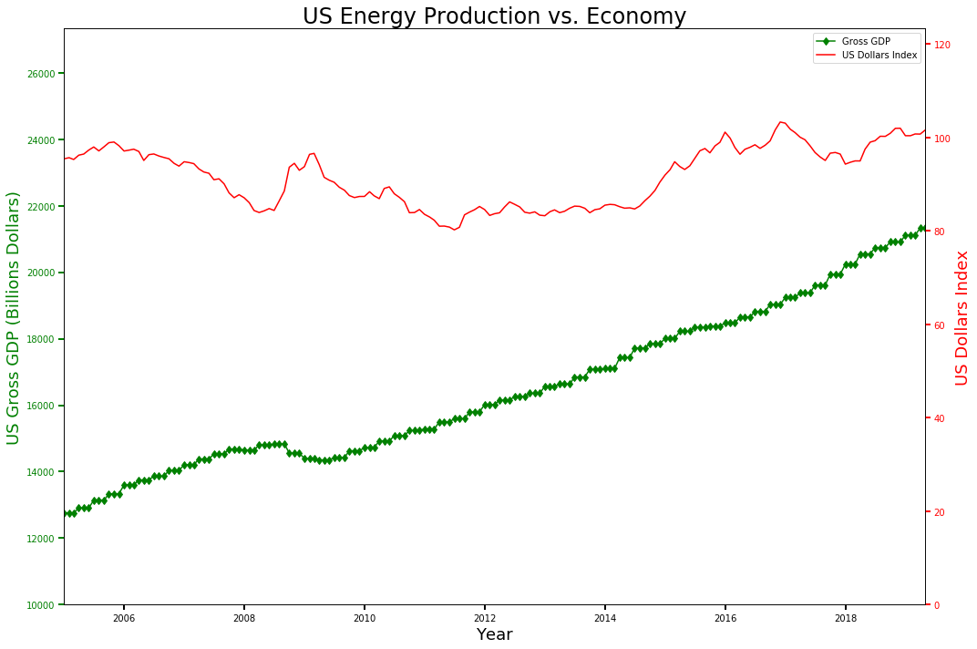
Findings – US Energy & Economy
Over the past 15 years:
Linear growth of US GDP (1.5x) while US Dollars Index follows a cyclical trend and increases by (1.05x)
Recession
 | Crude Prod. | US GDP
US GDP |  | -
USD Index |  | 0.37
*** GDP indicates the size of a country’s economy. Higher GDP = healthier economy ***
*** US Dollars Index indicates the dollar’s value in global markets . It is affected by inflation, recessions, and economic growth***
Notes:
Thao
1st graph we looked at the correlation between US GDP (green) and US dollar index (red)
US Dollar Index definition: ___
GDP definition: ____
Higher GDP = healthier economy = expected higher dollar strength
Describe the graph…

Slide 11
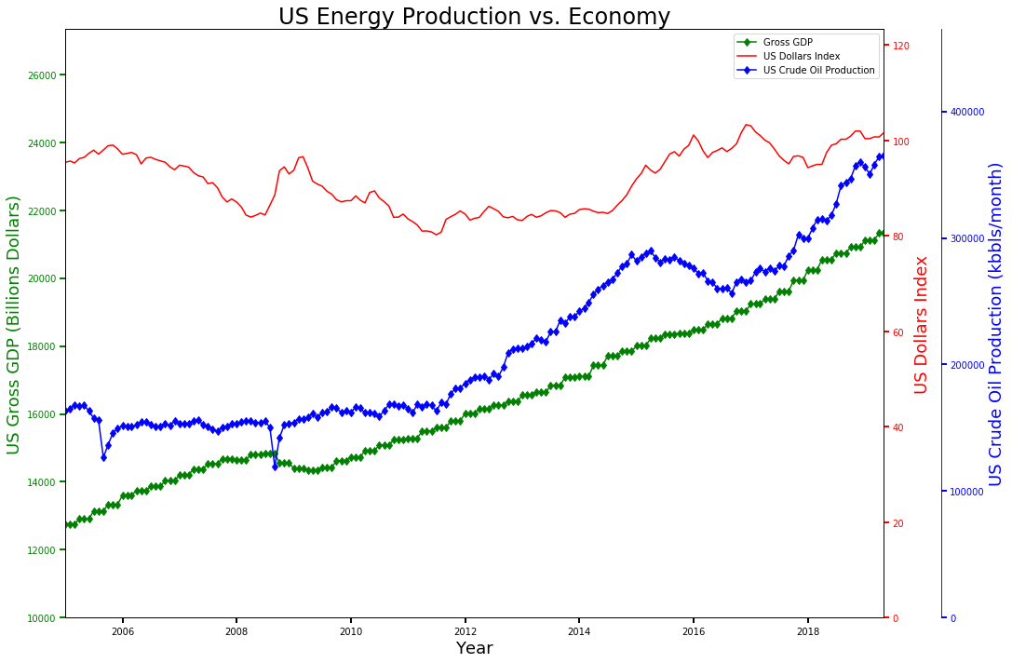
Findings – US Energy & Economy
Over the past 15 years:
Linear growth of US GDP while US Dollars Index follows a cyclical trend
curtailment
Linear growth of US Crude Production with some curtailments in 2015-2016
 | Crude Prod. | US GDP
US GDP | 0.96 | -
Notes:
Thao
Then we added US crude production (blue) to the same graph
1st, we see an obvious correlation berween crude production and US GDP, correlation coefficient = 0.96
→ So crude production has some impacts on US GDP
But neither crude production nor GDP has strong correlation with USD Index, 0.44 and 0.37 respectively
→ we don’t understand why but it’s kinda expected because dollar strength is not only impacted by economic activity, but also other factors such as market psychology ad geopolitical risks

Slide 12
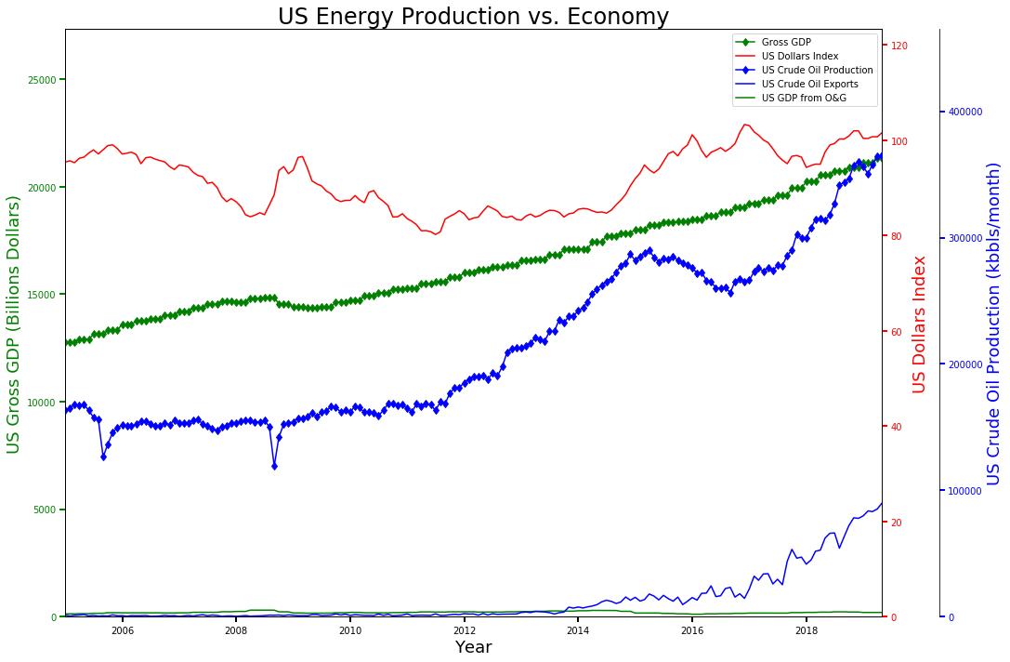
Findings – US Energy & Economy
US Crude Exports increases from ~0% before 2012 to ~25% in 2019
But GDP contribution from O&G only accounts for ~1% of Gross GDP
→ No expected correlation with neither GDP nor US Dollar Index
 | Crude Prod. | US GDP
US GDP | 0.96 | -
USD Index | 0.44 | 0.37
*** US Dollars Index indicates the dollar’s value in global markets . It is affected by inflation, recessions, and economic growth***
Notes:
Thao
Then finally we graphed Crude export (thin blue) and USD GDP from Crude production (thin green) to have a perspective of hos significant they are to the US economy
We see that the majority of oil production from us was for domestic use until after 2012 when they started exported some of what that made. 25% increase. But since the total GDP from oil and gas extraction only accounts for about 1% of US gross GDP, we wont expect oil production nor oil export has great impacts on the US economy, which is showed in this graph

Slide 13
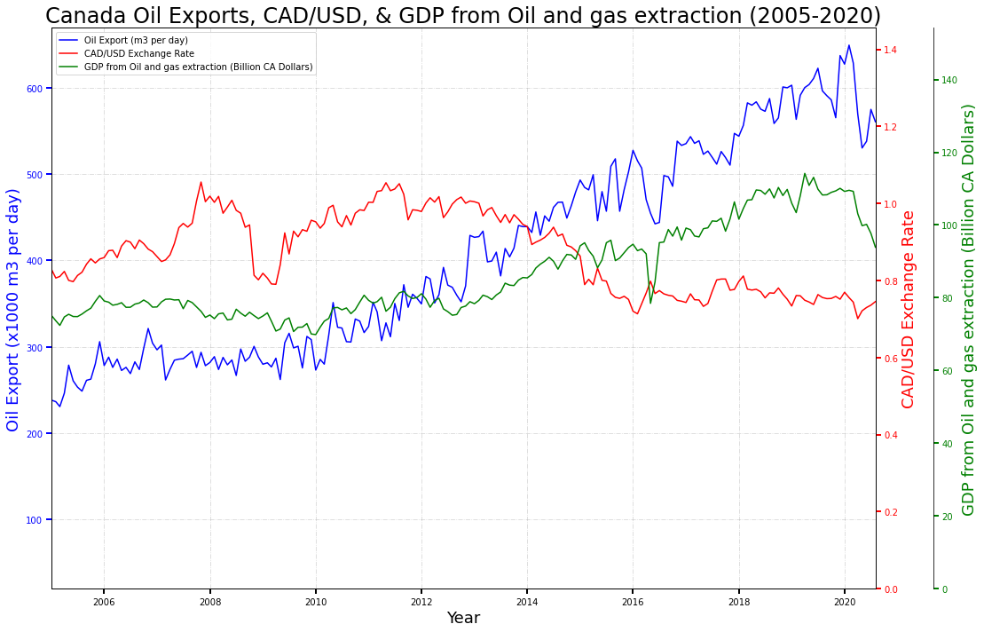
Findings – Canadian Energy & Economy
Over the past 15 years:
- CAD/USD rate decreases (CAD strengthens as export ↑ )
 | Crude Export | GDP from O&G
GDP from O&G | 0.95 | -
CAD/ USD Exchange Rate | -0.64 | -0.71
Notes:
Thao
Strong correlation between Crude Export and GDP from O&G because as we saw on the 1st slide, 87% of Canadian crude production is exported, in which 95% is sent to US, bring more USD dollars flow into Canada, which strengthen the Canadian economy
But we do not see the similar correlation between crude export and GDP from O&G with Exchange rate because again, exchange rate is impacted by many other factors besides just economic activities.

Slide 14
Findings – Renewable Sources vs Oil Sources
Renewable Sources
Oil Sources (Not Clean)
Wood
Waste
Geothermal
Solar
Wind
Conventional Hydroelectric Power
Coal
Petroleum
Natural Gases
Other Gases
Notes:
- May

Slide 15
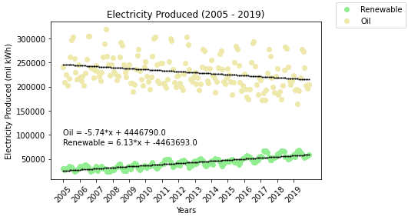
Findings – US Electricity Production by Source
Slope is in mil kWh/month
Point of intersect :
Nov 2055
Production from renewable sources increases as the other decreases
Notes:
- May

Slide 16
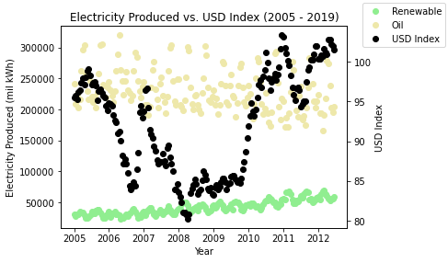
Findings – Electricity Production vs. US Dollars
Over the past 15 years:
 | Renewable Production
US Dollars Index | None
Notes:
- May

Slide 17
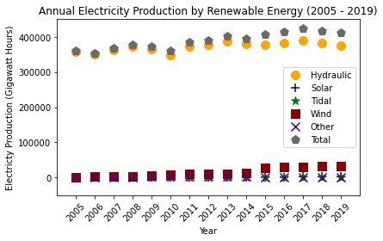
Findings – Canada Electricity Production by Sources
Overall renewable energy production is growing
Majority is from Hydraulic turbine, followed by wind power turbine
Notes:
Su
Hydraulic takes up to 90% of renewable energy source to produce electricity, In Canada, moving water providing about 60% of Canada’s electricity generation. In fact, Canada is the second largest producer of hydroelectricity in the world
wind with its rapid increase in these few years, It can take up to almost 8% by 2019. Electricity from wind energy is one of the fastest growing sources of electricity in Canada
Rest renewable energy source only takes up 2 to 3%.

Slide 18
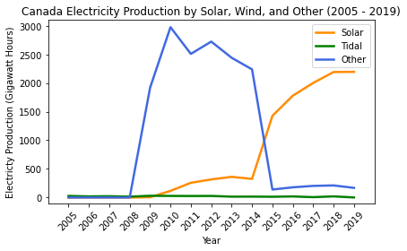
Findings – Canada Electricity Production by Sources
Overall renewable energy production is growing
Majority is from Hydraulic turbine, followed by wind power turbine
Solar production is increasing but tidal power turbine is slowly decreasing
Others seem to be inflated by the recession of Canada’s economy
Notes:
Su
In 2009, Canada first start using solar and other types of energy sources to produce electricity.
However, a number of technical, economic and environmental barriers remain and, as a result, ocean energy is currently not a widely exploited energy source. Tidal energy can only produce electricity during tidal surges, limiting to 10 hours per day, and it is a fairly new and quite expensive technology.

Slide 19
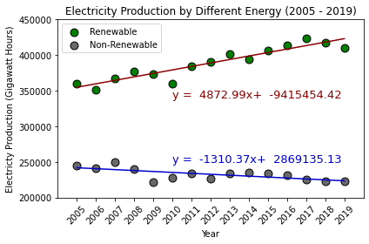
Findings – Comparison between Renewable and Nonrenewable Production
Overall, Production from renewable sources increases as the Non-Renewable sources decreases
Canada’s electricity production is mainly from renewable energy (mainly due to hydraulic energy)
Notes:
- Su

Slide 20
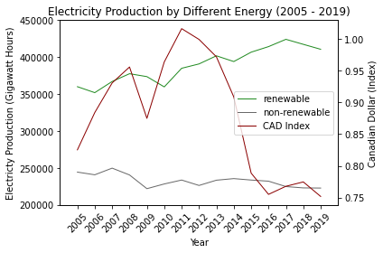
Findings – Electricity Production vs. Canadian Dollars
Production from non-renewable sources decreases as the Canadian Dollar Index increases
Production from renewable sources increases as the Canadian Dollar Index decreases
This data is only for electricity production, cannot accurately present the relationship between crude oil production and Canadian dollar index
Notes:
- Su

Slide 21
Assumptions
Analysis used nominal GDP and not inflation-adjusted, so it does not represent the true growth
First date of the month was representative of the entire month
Assume U.S dollar is a fairly stable currency, and we use CAD/USD index to represent the currency change in Canadian dollars.
US Dollars Index only factor the exchange rates of six major currencies: EUR< JPY, CAD, GBP, SEK, CHF, with EUR weighted about 58%, the rest of currencies weighted between 3-13% each.
Notes:
- May

Slide 22
Next steps
Derive Real GDP from nominal GDP by considering the inflation rate over the years, and re-examine the correlations
Gain an understanding of other factors affecting dollars strength
Investigation into any new renewable energy initiatives (timing, production impact etc.)
Energy production is not limited to electricity
Should explore other uses of energy (e.g. Heating)
Notes:
- May

Slide 23
References
[1] | Statistics Canada, "Electric power generation, monthly generation by type of electricity," 9 11 2020. [Online]. Available: https://www150.statcan.gc.ca/t1/tbl1/en/tv.action?pid=2510001501. [Accessed 11 11 2020].
[2] | Statistics Canada, "Gross Domestic Product by Industry - National (Monthly) (GDP)," 30 10 2020. [Online]. Available: https://www150.statcan.gc.ca/t1/tbl1/en/tv.action?pid=3610043402. [Accessed 11 11 2020].
[3] | US Energy Information Administration, "Total Energy : Monthly Energy Review," 27 10 2020. [Online]. Available: https://www.eia.gov/totalenergy/data/monthly/index.php#electricity. [Accessed 11 11 2020].
[4] | MacroTrends, "U.S. Dollar Index - 43 Year Historical Chart," 12 2019. [Online]. Available: https://www.macrotrends.net/1329/us-dollar-index-historical-chart. [Accessed 11 11 2020].
[5] | US Energy Information Administration, "Petroleum & Other Liquids," 30 10 2020. [Online]. Available: https://www.eia.gov/dnav/pet/hist/LeafHandler.ashx?n=PET&s=MCREXUS2&f=M. [Accessed 11 11 2020].
[6] | Exchange Rates, "Foreign exchange rates API," 11 11 2020. [Online]. Available: https://exchangeratesapi.io/. [Accessed 11 11 2020].
[7] | Government of Canada, "Crude Oil - Exports," 29 10 2020. [Online]. Available: https://open.canada.ca/data/en/dataset/0b7bf4b3-423a-45d0-a92b-e69be0b81ce4. [Accessed 11 11 2020].
[8] | Bureau of Economic Analysis, "GDP by Industry," 6 10 2020. [Online]. Available: https://www.bea.gov/data/gdp/gdp-industry. [Accessed 11 11 2020].

Slide 24

Thank you for listening

Slide 25

Theory
CAD/USD Exchange Rate:
Exchange rate is strongly correlated to crude oil price
Oil price ↑ = CAD ↑
Exchange rate is dependant on supply/ demand of both currencies
CAD supply ↓ / CAD demand ↑ = CAD ↑
Crude oil price is determined by crude supply/ demand
Crude supply ↓ = Oil Price ↑

Slide 26
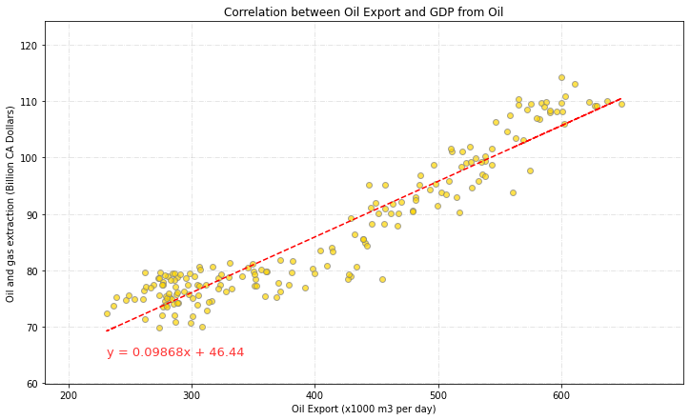
Findings – Canadian Energy & Economy
Notes:
Thao
Don’t think we need this graph, even though it looks amazing!!!

